Slide 1
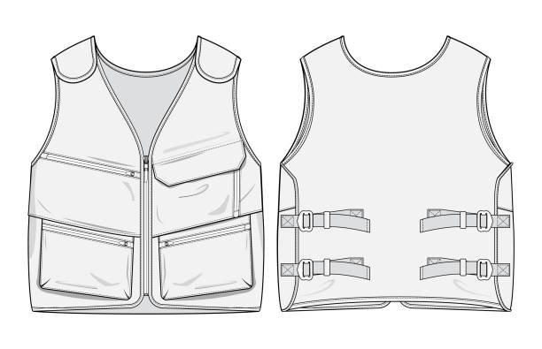
Vest, logo with IMC and KSR logos

Slide 2
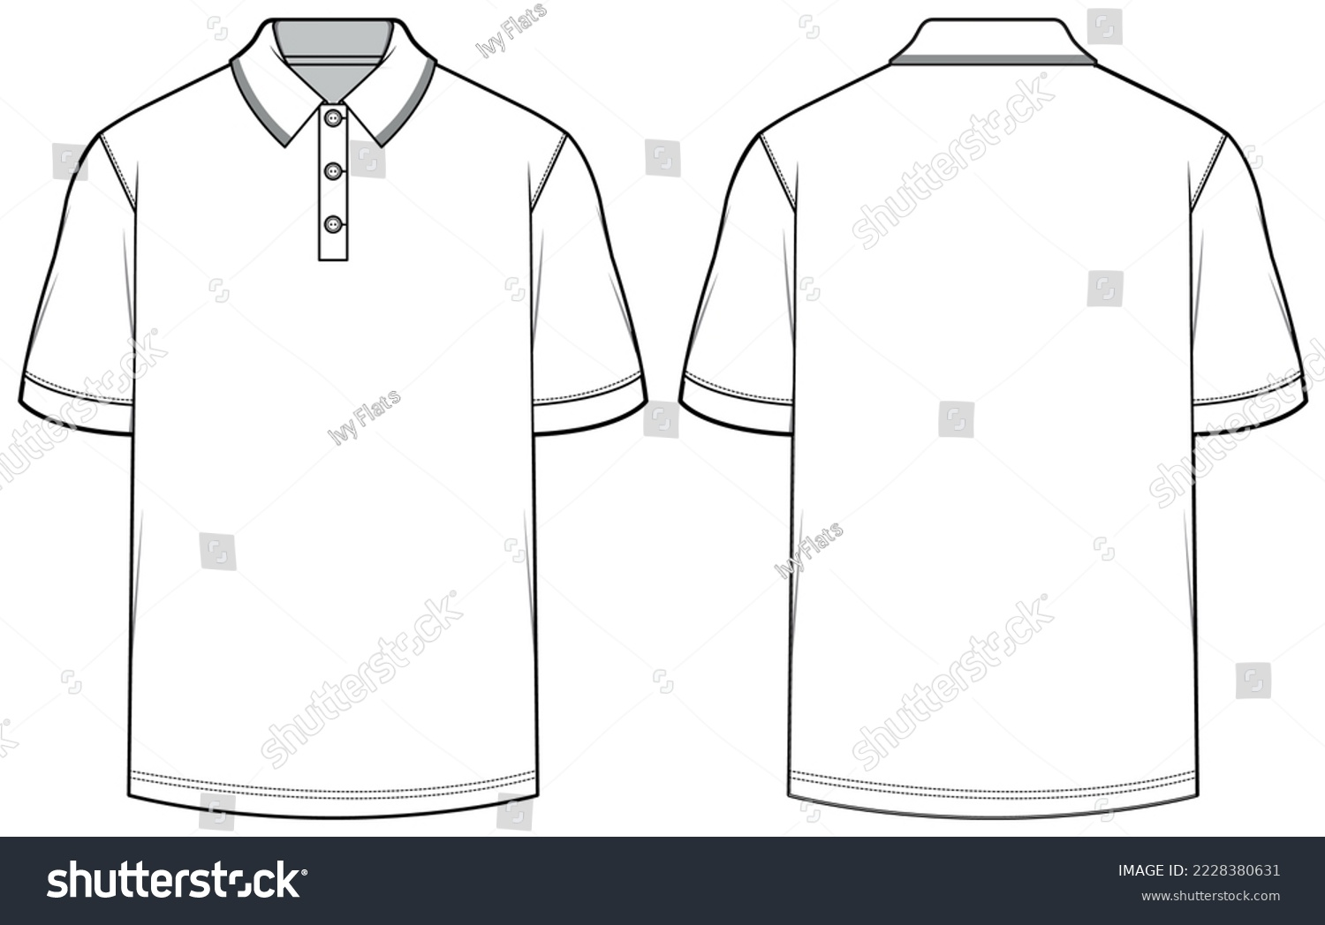
Collar neck T-shirts, unisex, Short sleeved IMC and KSR fine printed logos, white. 100% cotton.

Slide 3
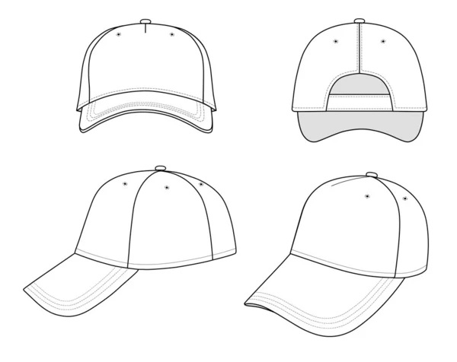
Baseball Caps, pantone gold and green colors, with KSR logo fine printed on rigid front panel with adjustable back tab.

Slide 4
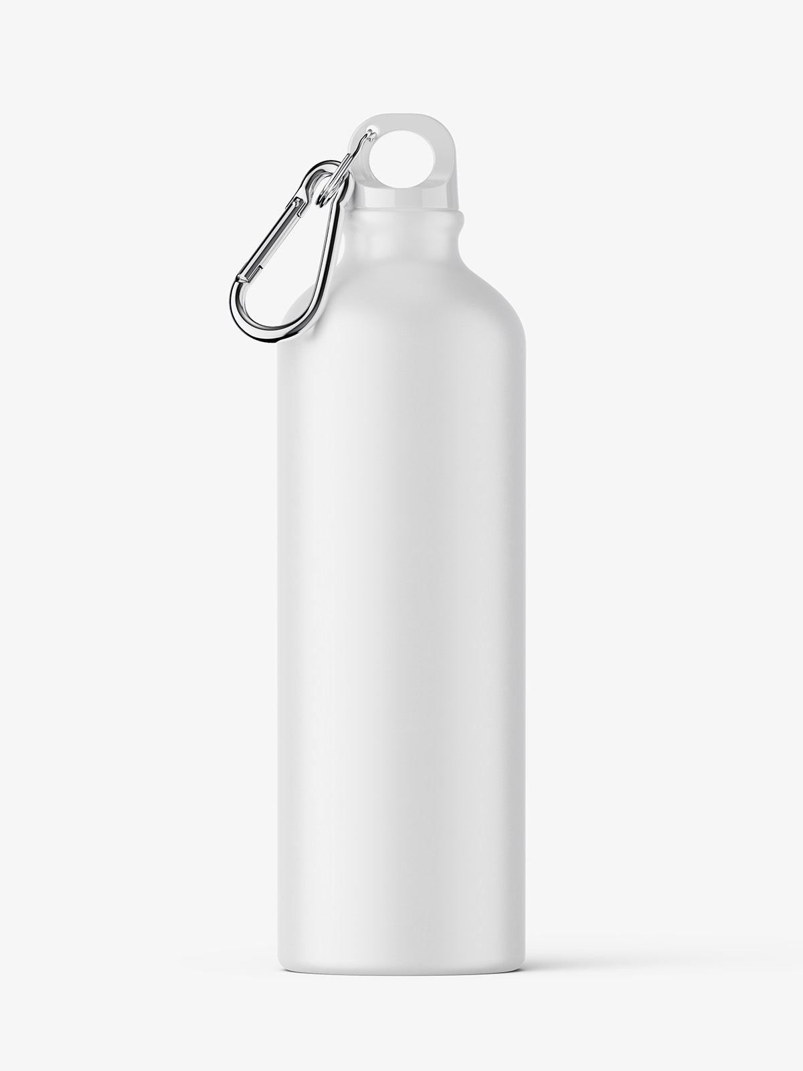
Water Bottle | Metallic, stainless steel, with straw, leakproof. With IMC and KSR logos printed on each side. 1 Liter

Slide 5
Stickers 15*15 cm, 30*30 cm Green/Gold Pantone KSR logo with the wording "Towards An Unrestricted Humanity"
Height 30CM
Height 15 CM
Funded by King Salman Humanitarian Aid and Relief Centre
Funded by King Salman Humanitarian Aid and Relief Centre
Length 15 cm
Length 30cm

